Slide 1


Adding Regular Expressions to Graph Reachability and Pattern Queries
Wenfei Fan Shuai Ma Nan Tang Yinghui Wu
University of Edinburgh
Jianzhong Li
Harbin Institute of Technology

Slide 2
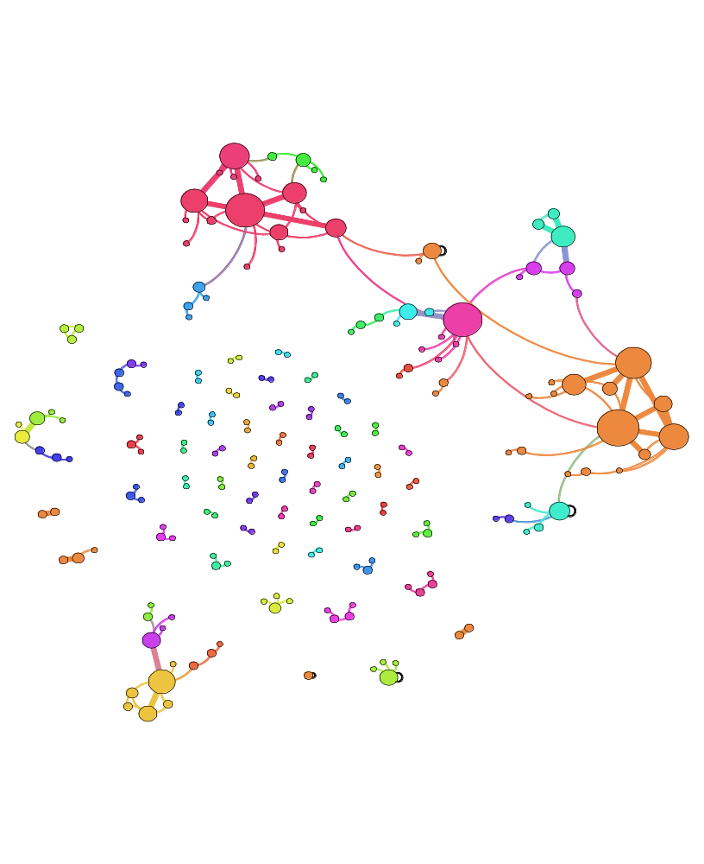

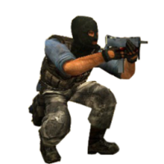
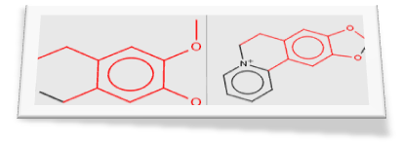
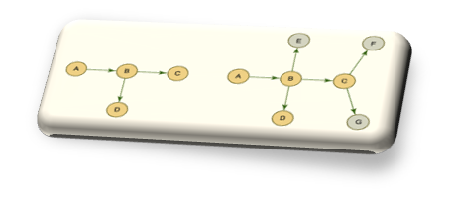






Adding Regular Expressions to Graph Reachability and Pattern Queries
Wenfei Fan, Jianzhong Li, Shuai Ma, Nan Tang, Yinghui Wu
University of Edinburgh Harbin Institute of Technology
Real-life networks are huge and complex.
Traditional function-based querying model – capable enough?
Reachability Queries and Graph Pattern Queries: novel query model and method for querying large, complex networks
Terrorist Collaboration Network
1970 - 2010
“Those who were trained to fly didn’t know the others. One group of people did not know the other group.” (Bin Laden)
<#>

Slide 3
Outline
Real-life graphs bear multiple edge types
  traditional models and methods may not be capable enough
Reachability Queries and Graph Pattern Queries
  nodes carrying predicates
  edges carrying regular expressions
Fundamental problems
  query containment and equivalence
  query minimization
Query evaluation
  Join-based and Split-based algorithms
Conclusion
A first step towards revising simulation for graph pattern matching
Notes:
Sometimes you use “edge to path”, and sometimes “edge-to-path”, better to uniform them

Slide 4
Graph Pattern Matching: the problem
Given a pattern graph (a query) P and a data graph G , decide whether G matches P , and if so, find all the matches of P in G.
Applications
  social queries, social matching
  biology and chemistry network querying
  key work search, proximity search, …
How to define?
Widely employed in a variety of emerging real life applications
Notes:
Nan Tang: in the takeaway message, I won’t use two “application” s, you can use “Wide employed, used, etc”

Slide 5
Subgraph isomorphism and Graph Simulation
Node label equivalence
Edge-to-edge function/relation
A
A
E
D
E
D
B
B
B
v₁
v₂
B
B
B
v₁
v₂
D
E
D
E
A
A
P
G
P
G
Capable enough?
Identical label matching, edge-to-edge function/relations

Slide 6




Considering edge types…
strangers-nemeses
Biologist
strangers-allies
friends-allies
friends-nemeses
Doctors
Businessman
Alice the journalist
Essembly: a social voting network
Real life graphs have multiple edge types

Slide 7



Querying Essembly network: an example
fa+
strangers-nemeses
Biologists supporting cloning
strangers-allies
fa^{<=2} sa^{<=2}
friends-allies
fa^{<=2} sn
friends-nemeses
fn
…
Alice
Doctors against cloning
fn
Pattern
Essembly Network
Pattern queries with multiple edge types

Slide 8
Graph reachability and pattern queries
Real life graphs usually bear different edge types…
    data graph G = (V, E, f_{A} , f_{C})
  Reachability query (RQ) : (u₁, u₂, f_{u1}, f_{u2}, f_{e}) where f_{e} is a subclass of regular expression of:
    F ::= c | c^{≤k} | c⁺ | FF
Q_{r}(G): set of node pairs (v₁, v₂) that there is a nonempty path from v₁ to v₂ , and the edge colors on the path match the pattern specified by f_{e}.
Job=‘biologist’, sp=‘cloning’
fa^{<=2} fn
Job=‘doctors’

Slide 9

Graph pattern queries
graph pattern queries PQ Q_{p} =(V_{p}, E_{p}, f_{v} , f_{e}) where for each edge e=(u,u’), Q_{e}=(u₁, u₂, f_{v}(u) , f_{v}(u’), f_{e}(e)) is an RQ.
Q_{p}(G) is the maximum set (e, S_{e}) (unique!)
  for any e₁(u₁,u₂) and e₂(u₂ ,u₃), if (v₁,v₂) is in S_{e1}, then there is a v₃ that (v₂,v₃) is in S_{e2} .
  for any two edges e₁(u₁,u₂) and e₂(u₁ ,u₃), if (v₁,v₂) is in S_{e1}, then there is a v₃ that (v₁,v₃) is in S_{e2}
PQ vs. simulation
  search condition on query nodes
  mapping edges to paths
  constrain the edges on the path with a regular expression
fa+
RQ and simulation are special cases of PQ
fa<=2 sa<=2
Job=‘biologist’,
sp=‘cloning’
fa<=2 sn
fn
Id=‘Alice’
Job=‘doctors’
dsp=‘cloning’
fn

Slide 10


Reachability and graph pattern query: examples
fa+
Job=‘biologist’, sp=‘cloning’
sn
fa<=2 sa<=2
Job=‘biologist’, sp=‘cloning’
sa
fa<=2 sn
fa
fa^{<=2} fn
fn
fn
Id=‘Alice’
Job=‘doctors’
dsp=‘cloning’
fn
Job=‘doctors’
fa fa fa
fa sa
fa sn
fa fn
fn
fn
fa fa fn
fa fn
fn
fa sn
fa fa fn
fn

Slide 11
Fundamental problems: query containment
PQ Q₁ (V₁, E₁, f_{v1} , f_{e1}) is contained in Q₂ (V₂, E₂, f_{v2} , f_{e2}) if there exists a mapping λ from E₁ to E₂ s.t for any data graph G and e in E₁, S_{e} is a subset of S_{λ(e)} , i.e., λ is a renaming function that Q₁(G) is mapped to Q₂(G).
Query containment and equivalence problems can all be determined in cubic time
  Query similarity based on a revision of graph simulation
  Determine the query similarity in cubic time
Query containment and equivalence for PQs can be solved efficiently

Slide 12
Query containment: example
B₁
B₂
B₃
h^{<=1}
h^{<=3}
h^{<=1}
h^{<=3}
h^{<=1}
h^{<=2}
C₁
C₂
C₃
C₄
C₅
C₆
Q₁
Q₂
Q₃
Q₂ is contained in Q₁ and Q₃
Q₁ and Q₃ are equivalent

Slide 13
Fundamental problems: query minimization
size of a query: |Vp| + |Ep|
Query minimization problem
  input: a PQ Q_{p}
  output: a minimized PQ Q_{m} equivalent to Q_{p}
Query minimization problem can be solved in cubic time in the size of the query:
  compute the maximum node equivalent classes based on a revision of graph simulation;
  determine the number of redundant nodes and edges based on the equivalent classes;
  remove redundant and isolated nodes and edges
Query minimization for PQs can be solved efficiently

Slide 14
query minimization: example
R
R
R
g
f
g
f
g
f
B
B
B
B
B
B
g^{<=3}
g^{<=3}
h^{<=2}
g^{<=3}
g^{<=3}
h^{<=2}
g^{<=3}
h^{<=2}
g^{<=3}
h^{<=2}
h^{<=2}
h^{<=2}
C
C
C
C
C
C
C
C
Q₁
Q₂
Q₃

Slide 15
Evaluating graph pattern queries
PQ can be answered in cubic time.
  Join-based Algorithm JoinMatch
    Matrix index vs distance cache
    join operation for each edge in PQ until a fixpoint is reached (wrt. a reversed topological order)
  Split-based Algorithm SplitMatch
    blocks: treating pattern node and data node uniformly
    partition-relation pair
Graph pattern matching can be solved in polynomial time

Slide 16








Example of JoinMatch
fa+
sn
fa<=2 sa<=2
Job=‘biologist’, sp=‘cloning’
sa
fa<=2 sn
fa
fn
fn
Id=‘Alice’
Job=‘doctors’
dsp=‘cloning’
fn
Step 1: identify the candidates for each query node

Slide 17

Example of JoinMatch
fa+
sn
fa<=2 sa<=2
Job=‘biologist’, sp=‘cloning’
sa
fa
fa<=2 sn
fn
fn
Id=‘Alice’
Job=‘doctors’
dsp=‘cloning’
fn
Step 2: filter the candidate sets for each query edge

Slide 18

Example of JoinMatch
fa+
sn
fa<=2 sa<=2
Job=‘biologist’, sp=‘cloning’
sa
fa
fa<=2 sn
fn
fn
Id=‘Alice’
Job=‘doctors’
dsp=‘cloning’
fn
Step 2: filter the candidate sets for each query edge

Slide 19

Example of JoinMatch
fa+
sn
fa<=2 sa<=2
Job=‘biologist’, sp=‘cloning’
sa
fa
fa<=2 sn
fn
fn
Id=‘Alice’
Job=‘doctors’
dsp=‘cloning’
fn
Step 2: filter the candidate sets for each query edge

Slide 20
Example of JoinMatch
fa+
sn
fa<=2 sa<=2
Job=‘biologist’, sp=‘cloning’
sa
fa
fa<=2 sn
fn
fn
Id=‘Alice’
Job=‘doctors’
dsp=‘cloning’
fn
Step 3: return the final result

Slide 21
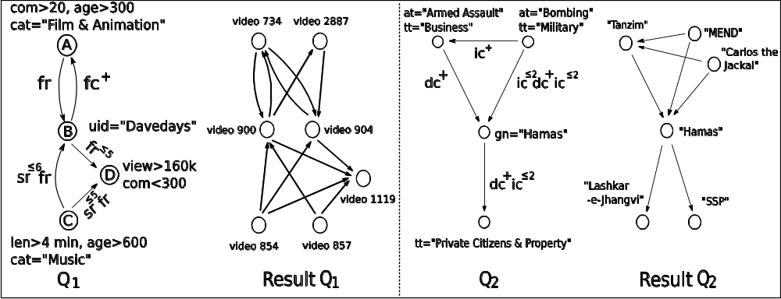
Experimental results – effectiveness of PQs
Effectiveness of PQs: edge to path relations

Slide 22
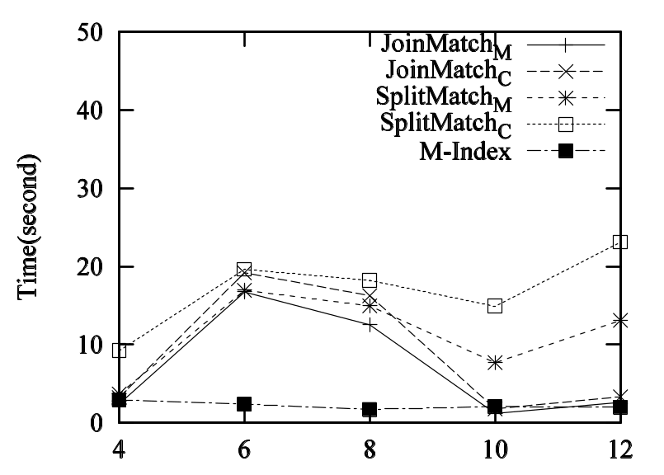
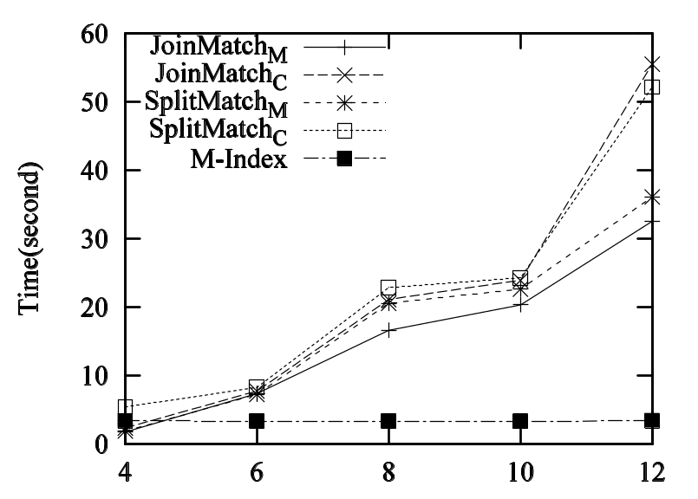
Experimental results – querying real life graphs
Varying |Vp|
Varying |Ep|
Size of query in average (8,15,3,4,5) for (|V|,|E|,|pred|,|c|,|b|)
Evaluation algorithms are sensitive to pattern edges

Slide 23
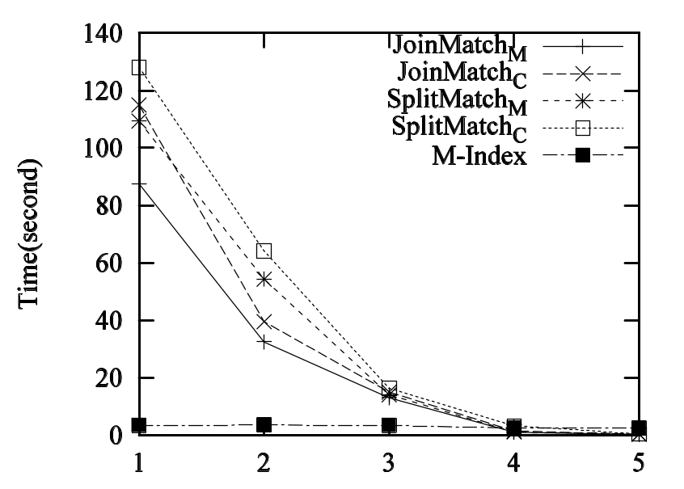
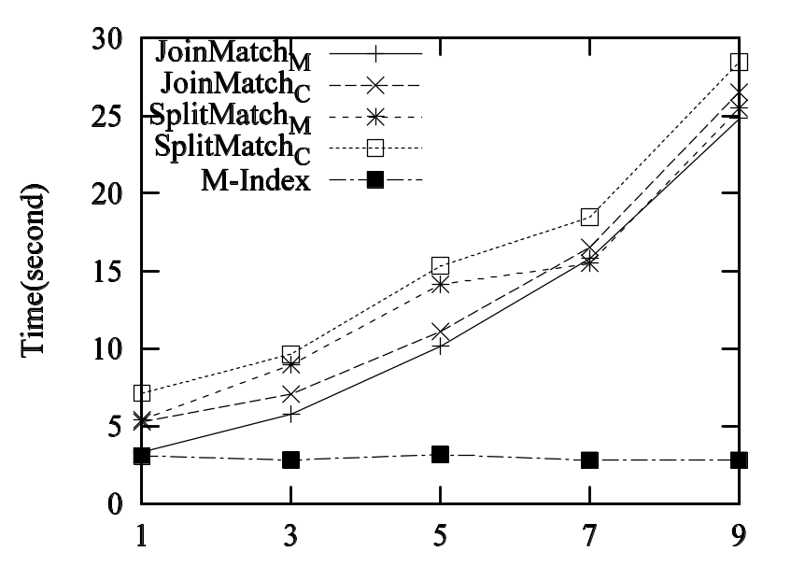
Experimental results – querying real life graphs
Varying |pred|
Varying b
The algorithms are sensitive to the number of predicates

Slide 24
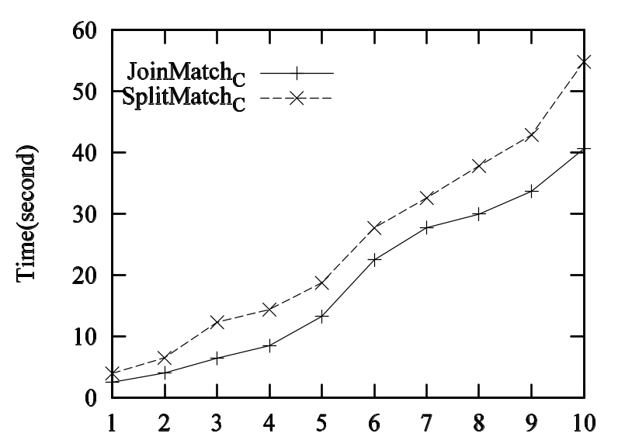
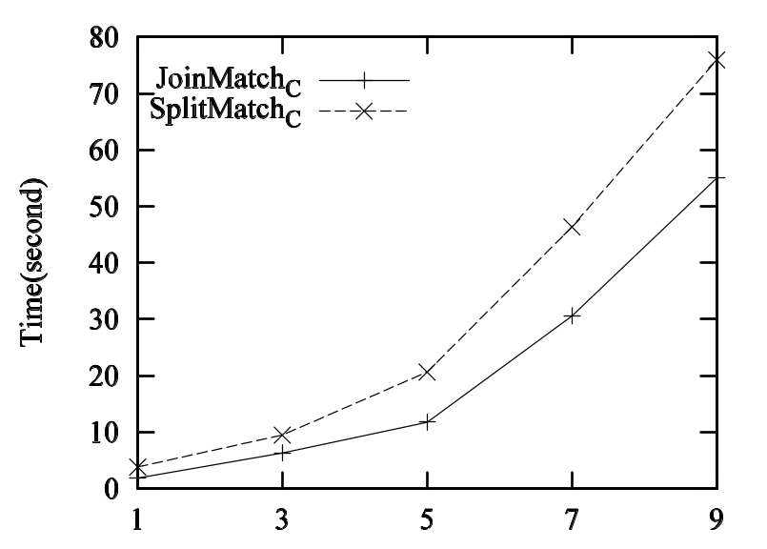
Experimental results – querying synthetic graphs
Varying |V| (x10⁵)
Varying b
The algorithms scale well over large synthetic graphs

Slide 25
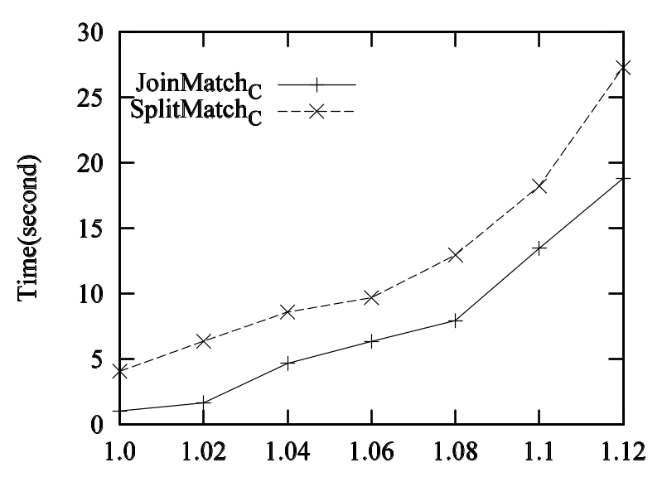
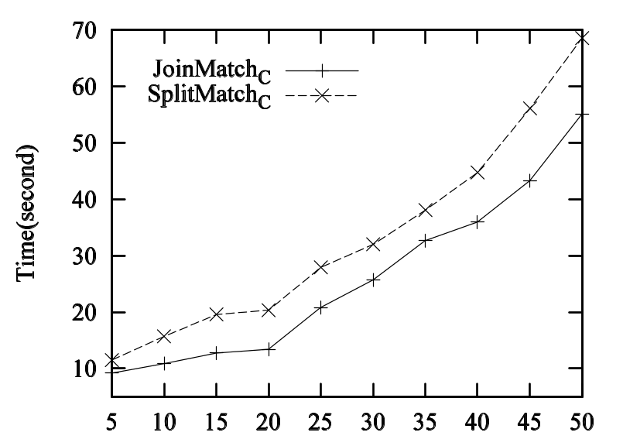
Experimental results – querying synthetic graphs
Varying α
E=V^{α}
Varying cr
|sim(u)|<=V*cr
The algorithms scale well over large synthetic graphs

Slide 26
Conclusion
Simulation revised for graph pattern matching
  Reachability Queries and Graph Pattern Queries
    query containment and minimization – cubic time
    query evaluation – cubic time
Future work
  extending RQs and PQs by supporting general regular expressions
  incremental evaluation of RQs and PQs
Simulation revised for graph pattern matching

Slide 27
Thank you!
Q&A
Terrorist Collaboration Network (1970 - 2010)
“Those who were trained to fly didn’t know the others. One group of people did not know the other group.” (Bin Laden)

